Slide 1
Practical applications of index laws

Slide 2
Indices in Real life
If you have ever used a computer, mobile phone, or media player such as an iPod or iPad, you have probably heard of terms such as ‘bit’ and ‘byte’, or more likely ‘kilobyte’ (kB), ‘megabyte’ (MB) or ‘gigabyte’ (GB). These words are used to describe the capacity of these devices to store documents, web pages, text messages, photos, music or videos in the form of electronic data.
The common values for storage sizes are 1gb, 2gb, 4gb, 8gb, 16gb, 32gb, 64gb, 128gb, 256gb, 512gb and 1024gb (1TB).
Is there a pattern for these given sizes?

Slide 3
Size pattern for Storage
The sizes in the previous examples double, from one to the next.
1 x 2 =2, 2x2 = 4, 4x2=8 ect.. So how does this relate to indices?
The way the we establish data size is with binary code, which uses powers of 2.
2⁰ = 1 gb
2¹ = 2 gb
2² = 4 gb
2³ = 8 gb
See the pattern?

Slide 4
Use the table below to determine the total number of bytes in the following devices
A 64gb Samsung S7
A 32mb flash movie
A 256kb email
A 3.5Mb powerpoint
A 174kb word document
a) 64 x 1073741824 = 68,719,476,736 bytes
32 x 1048576= 33,554,432 bytes
256 x 1024 = 262,144 bytes
3.5 x 1048576 = 3,670,016 bytes
174 x 1024 = 178,176 bytes
Prefix | Symbol | Decimal value | Binary value
kilo | Kb | 10³ (1000) | 2¹⁰ = 1024
mega | Mb | 10⁶ (1000000) | 2²⁰ = 1048576
giga | Gb | 10⁹ (1000000000) | 2³⁰ = 1073741824
tera | Tb | 10¹² (1000000000000) | 2⁴⁰ = 1099511627776
peta | Pb | 10¹⁵ (1000000000000000) | 2⁵⁰ = 1125899906842624
exa | Eb | 10¹⁸ (1000000000000000000) | 2⁶⁰ = 1152921504606846976

Slide 5
Another example: Decibel ratings
The intensity of sound is measured in watts per square metre. The level of sound (loudness) is measured in decibels.
The lowest sound that humans can hear is 10⁻¹² watts/m² and is defined as a level of sound of 0 decibels (dB). This is where our hearing starts.
All other decibel levels are calculated by comparing the sound intensity with the threshold of human hearing. To do this we follow a simple rule.
Decibel’s are multiples of each other.

Slide 6
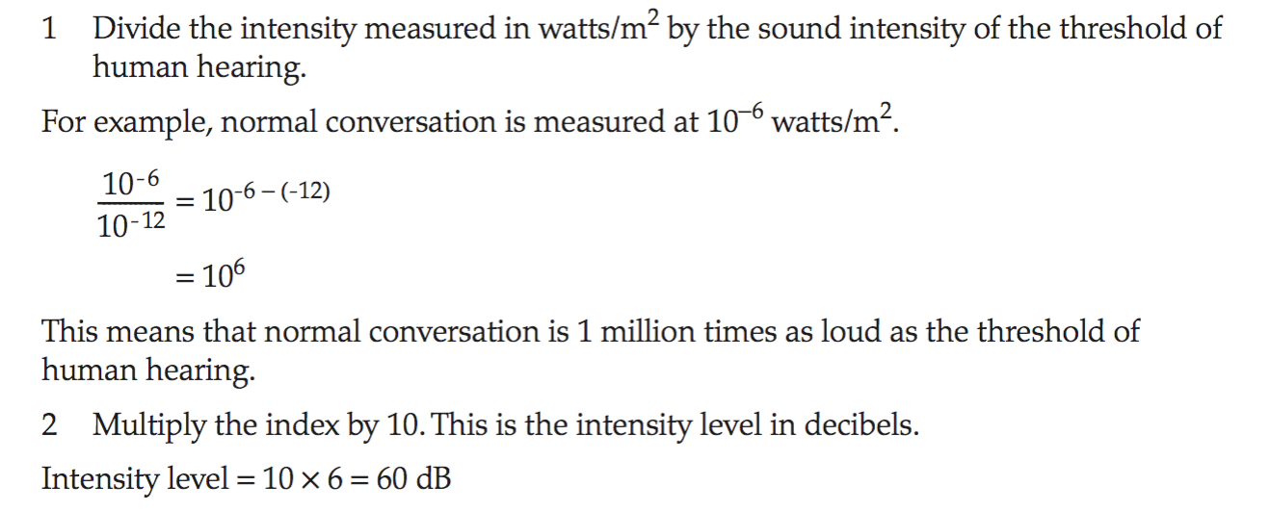
Working out decibels:

Slide 7
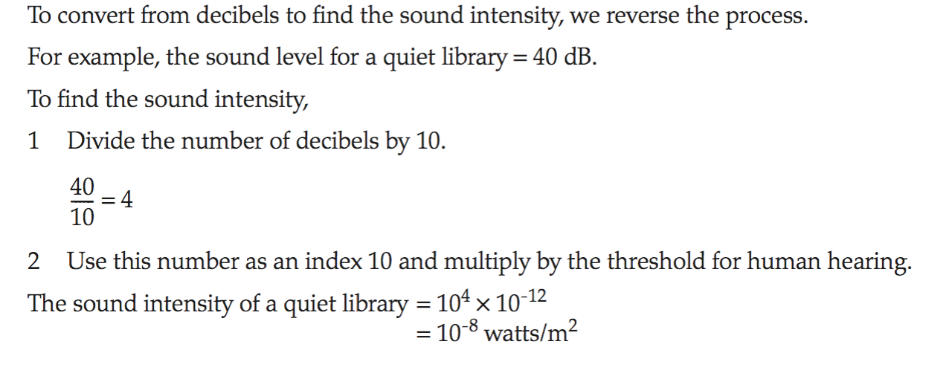
Decibels in reverse

Slide 8
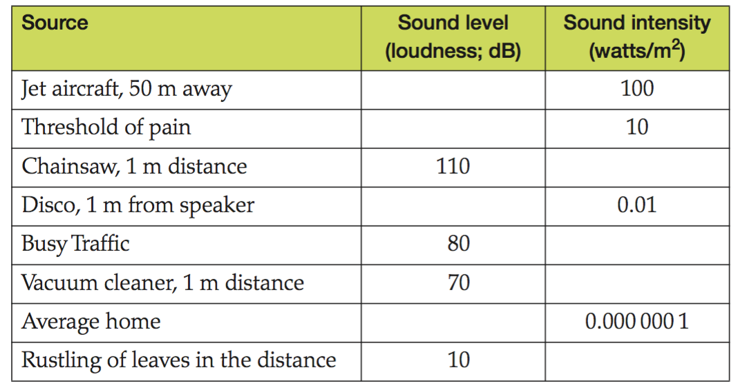
Have a go at finding the watts/db’s below

